Slide 1
CSE 205
Digital Logic Design
Lecture 2
Dr. Mahmuda Naznin

Slide 2
This Week
Review of last lecture
K-Map

Slide 3
Canonical & Standard Forms
Consider two binary variables x, y and the AND operation
four combinations are possible: x.y, x’.y, x.y’, x’.y’
each AND term is called a minterm or standard products
for n variables we may have 2^{n} minterms
Consider two binary variables x, y and the OR operation
four combinations are possible: x+y, x’+y, x+y’, x’+y’
each OR term is called a maxterm or standard sums
for n variables we have 2^{n} maxterms
Canonical Forms:
Boolean functions are expressed as a sum of minterms or product of maxterms.

Slide 4
Minterms
x y z Terms Designation
0 0 0 x’.y’.z’ m0
0 0 1 x’.y’.z m1
0 1 0 x’.y.z’ m2
0 1 1 x’.y.z m3
1 0 0 x.y’.z’ m4
1 0 1 x.y’.z m5
1 1 0 x.y.z’ m6
1 1 1 x.y.z m7

Slide 5
Maxterms
x y z Designation Terms
0 0 0 M0 x+y+z
0 0 1 M1 x+y+z’
0 1 0 M2 x+y’+z
0 1 1 M3 x+y’+z’
1 0 0 M4 x’+y+z
1 0 1 M5 x’+y+z’
1 1 0 M6 x’+y’+z
1 1 1 M7 x’+y’+z’

Slide 6
Boolean Function: How to express algebraically? (Using Minterm)
Question: How do we find the function using the truth table?
Truth table example:
x y z F1 F2
0 0 0 0 0
0 0 1 1 1
0 1 0 0 0
0 1 1 0 1
1 0 0 1 1
1 0 1 1 1
1 1 0 1 0
1 1 1 1 0

Slide 7
Boolean Function: How to express algebraically ??
1. Form a minterm for each combination forming a 1
2. OR all of those terms
Truth table example:
x y z F1 minterm
0 0 0 0
0 0 1 1 x’.y’.z m1
0 1 0 0
0 1 1 0
1 0 0 1 x.y’.z’ m4
1 0 1 0
1 1 0 0
1 1 1 1 x.y.z m7
F1=m1+m4+m7= x’.y’.z+x.y’.z’+x.y.z = Σ(1,4,7)

Slide 8
Boolean Function: How to express algebraically ??
Truth table example:
x y z F2 minterm
0 0 0 0 m0
0 0 1 0 m1
0 1 0 0 m2
0 1 1 1 m3
1 0 0 0 m4
1 0 1 1 m5
1 1 0 1 m6
1 1 1 1 m7
F2=m3+m5+m6+m7 = x’.y.z+x.y’.z+x.y.z’+x.y.z = Σ(3,5,6,7)

Slide 9
Boolean Function: How to express algebraically (Using Maxterm)
1. Form a maxterm for each combination forming a 0
2. AND all of those terms
Truth table example:
x y z F1 maxterm
0 0 0 0 x+y+z M0
0 0 1 1
0 1 0 0 x+y’+z M2
0 1 1 0 x+y’+z’ M3
1 0 0 1
1 0 1 0 x’+y+z’ M5
1 1 0 0 x’+y’+z M6
1 1 1 1
F1=M0.M2.M3.M5.M6 = л(0,2,3,5,6)

Slide 10
Boolean Function: How to express algebraically
Truth table example:
x y z F2 maxterm
0 0 0 0 x+y+z M0
0 0 1 0 x+y+z’ M1
0 1 0 0 x+y’+z M2
0 1 1 1
1 0 0 0 x’+y+z M4
1 0 1 1
1 1 0 1
1 1 1 1
F=M0.M1.M2.M4=л(0,1,2,4)=(x+y+z).(x+y+z’).(x+y’+z).(x’+y+z)

Slide 11
Maxterms & Minterms: Intuitions
Minterms:
If a function is expressed as SUM of PRODUCTS, then if a single product is 1 the function would be 1.
Maxterms:
If a function is expressed as PRODUCT of SUMS, then if a single product is 0 the function would be 0.
Canonical Forms:
Boolean functions expressed as a sum of minterms or product of maxterms.

Slide 12
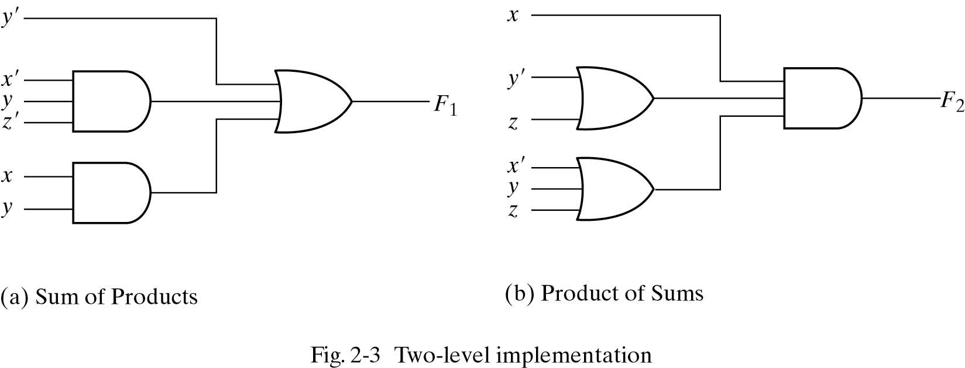
Standard Forms
Standard From: Sum of Product or Product of Sum

Slide 13
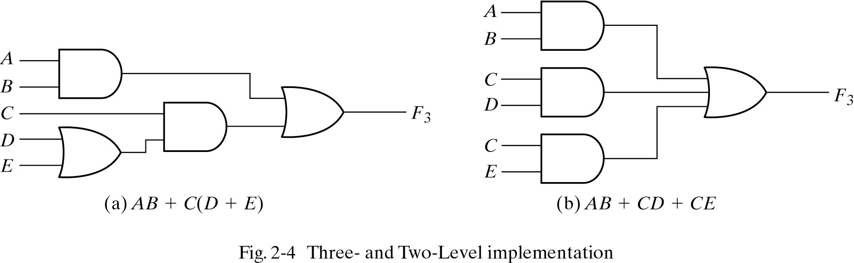
Nonstandard Forms
Nonstandard From: Neither a Sum of Product nor Product of Sum

Slide 14
Implementations
Three-level implementation vs. two-level implementation
Two-level implementation normally preferred due to delay importance.

Slide 15
Extension to Multiple Inputs
All gates -except for the inverter and buffer- can be extended to have more than two inputs
A gate can be extended to multiple inputs if the operation represented is commutative & associative
x+y=y+x
(x+y)+z=x+(y+z)

Slide 16
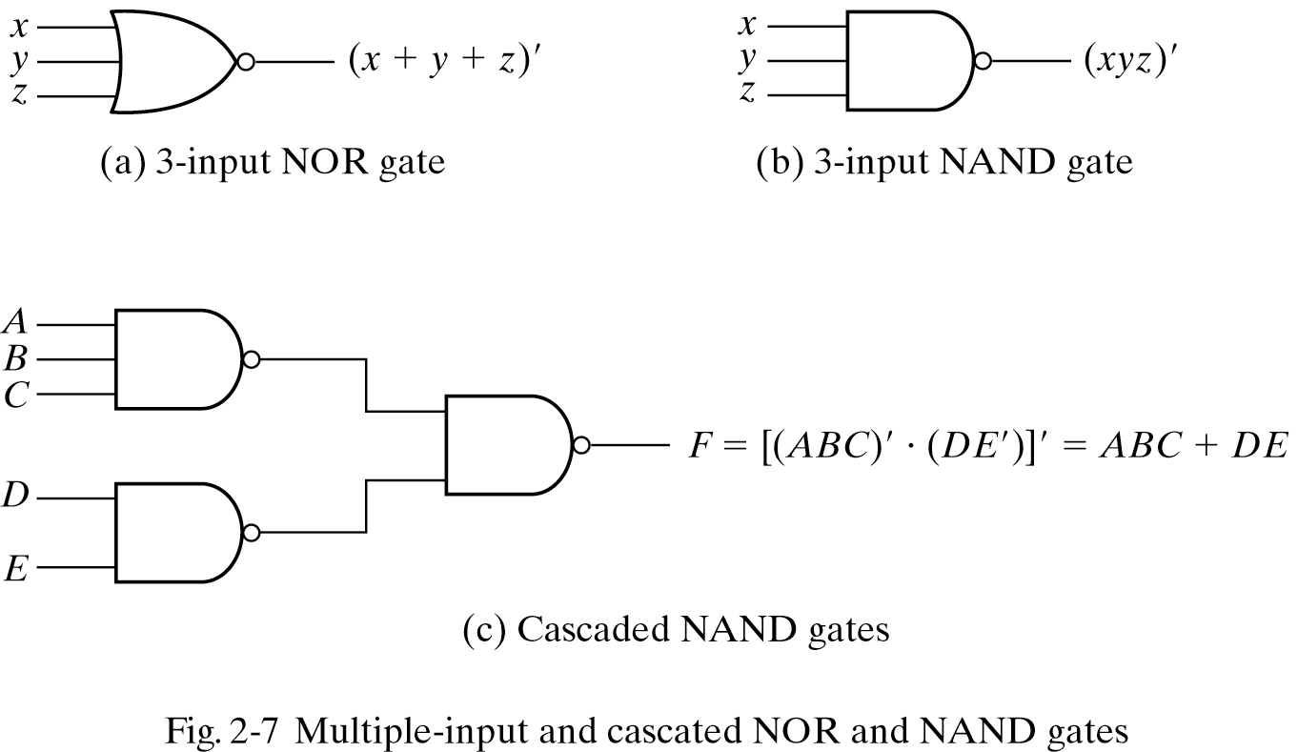
Extension to Multiple Inputs
We define multiple input NAND and NOR as:

Slide 17
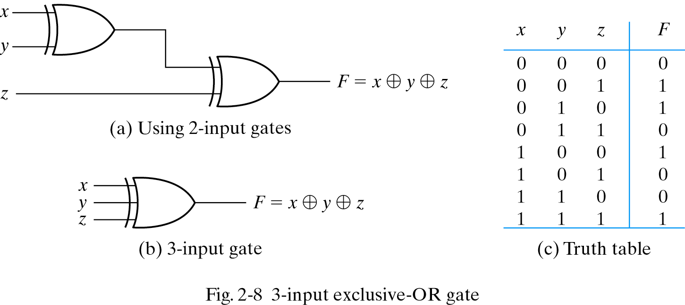
Extension to Multiple Inputs
What about multiple input XOR?
ODD function: 1 if the number of 1’s in the input is odd

Slide 18
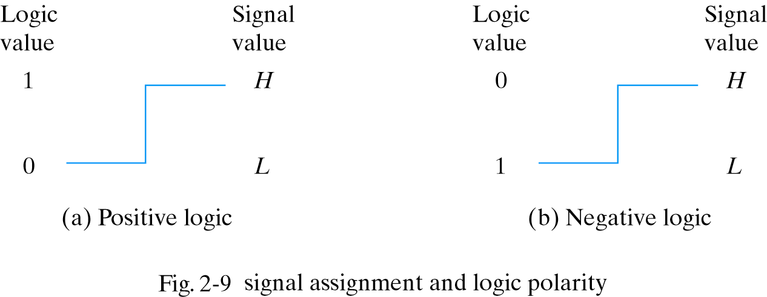
Positive and Negative Logic
Two values of binary signals

Slide 19
Integrated Circuits (ICs)
Levels of Integration
SSI: fewer than 10 gates on chip
MSI:10 to 1000 gates on chip
LSI: thousands of gates on chip
VLSI:Millions of gates on chip
Digital Logic Families
TTL transistor-transistor logic
ECL emitter-coupled logic
MOS metal-oxide semiconductor
CMOS complementary metal-oxide semiconductor

Slide 20
Digital Logic Parameters
Fan-out: maximum number of output signals
Fan-in : number of inputs
Power dissipation
Propagation delay
Noise margin: maximum noise

Slide 21
CAD- Computer-Aided Design
How do they design VLSI circuits????
By CAD tools
Many options for physical realization: FPGA, ASIC…
Hardware Description Language (HDL):
Represents logic design in textual format
Resembles a programming language

Slide 22
Gate-Level Minimization
The Map Method:
A simple method for minimizing Boolean functions
Map: diagram made up of squares
Each square represents a minterm

Slide 23
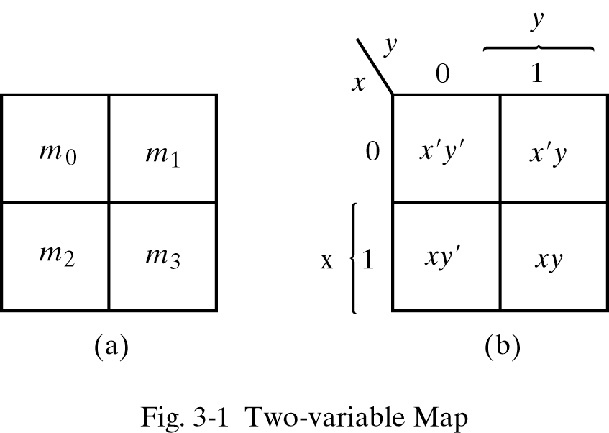
Two-Variable Map

Slide 24
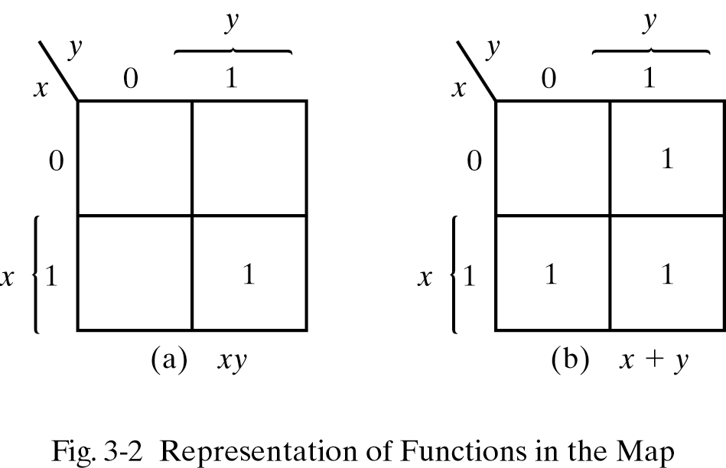
Two-Variable Map
Maps representing x.y and x+y

Slide 25
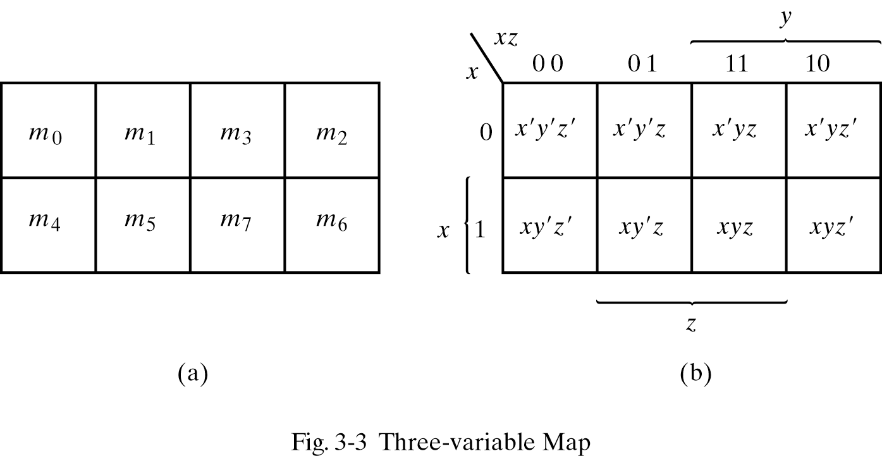
Three-Variable Map

Slide 26
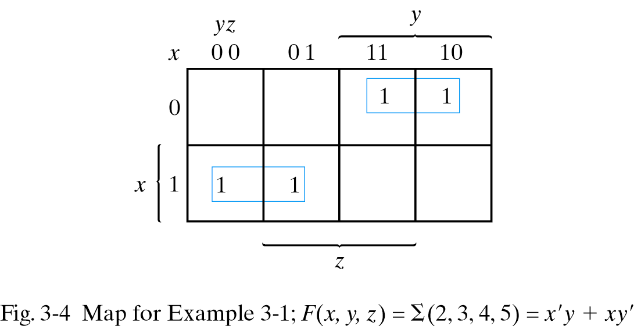
Three-Variable Map-example 1

Slide 27
Three-Variable Map
Minterms are not arranged in a binary sequence
Minterms arranged in gray code:
Only one bit changes from one column to the next

Slide 28
Three-Variable Map
Each variable is 1 in 4 squares, 0 in 4 squares
Each variable is 1 in 4 squares, 0 in 4 squares
Variable appears unprimed in squares equal to 1
Variable appears primed in squares equal to 0

Slide 29
Three-Variable Map-example 1
Sum of two adjacent minterms can be simplified
to a single AND term consisting of two literals

Slide 30
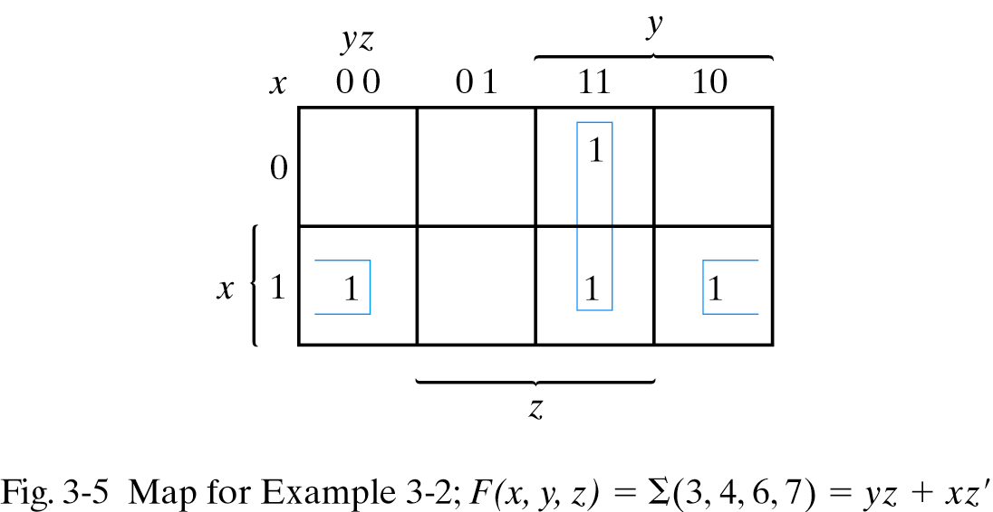
Three-Variable Map-example 2

Slide 31
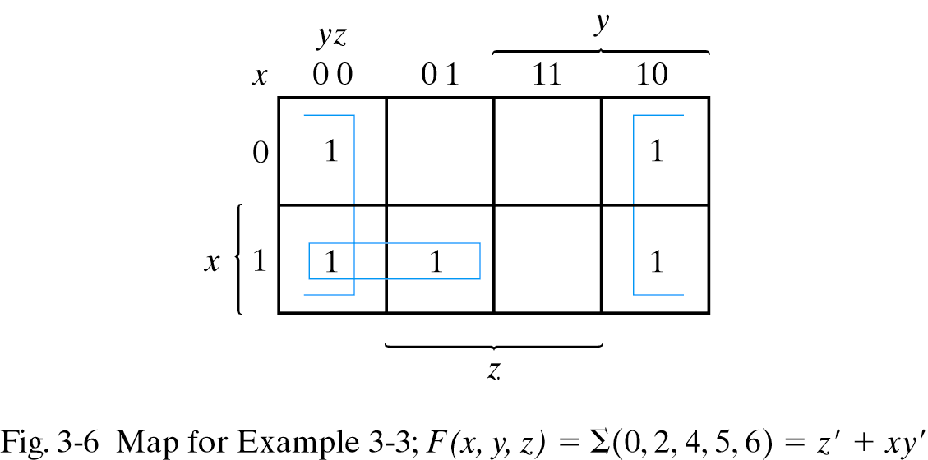
Three-Variable Map-example 3

Slide 32
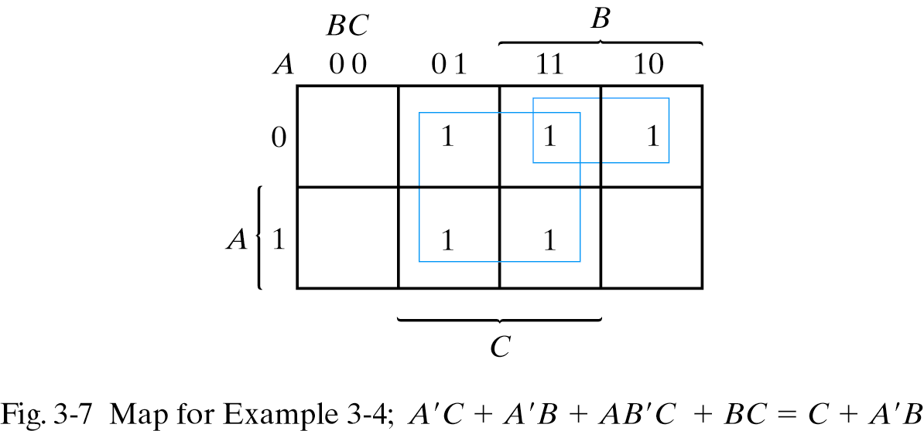
Three-Variable Map-example 4

Slide 33
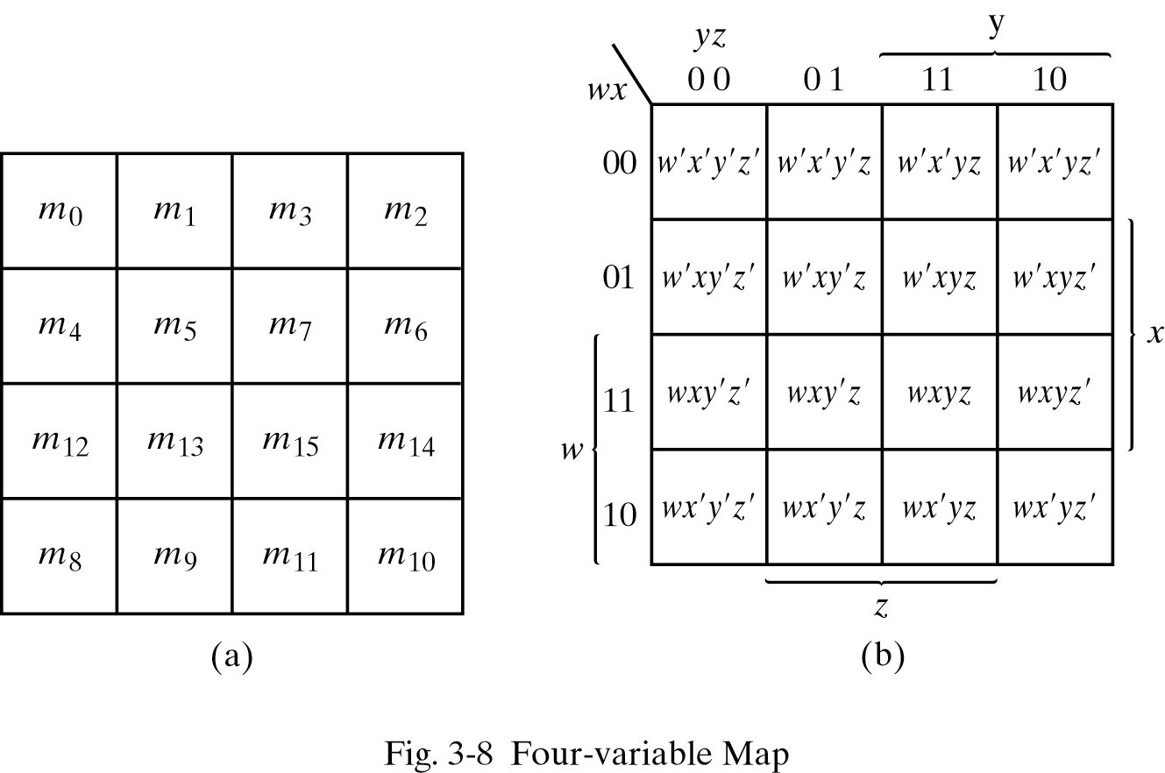
Four-Variable Map

Slide 34
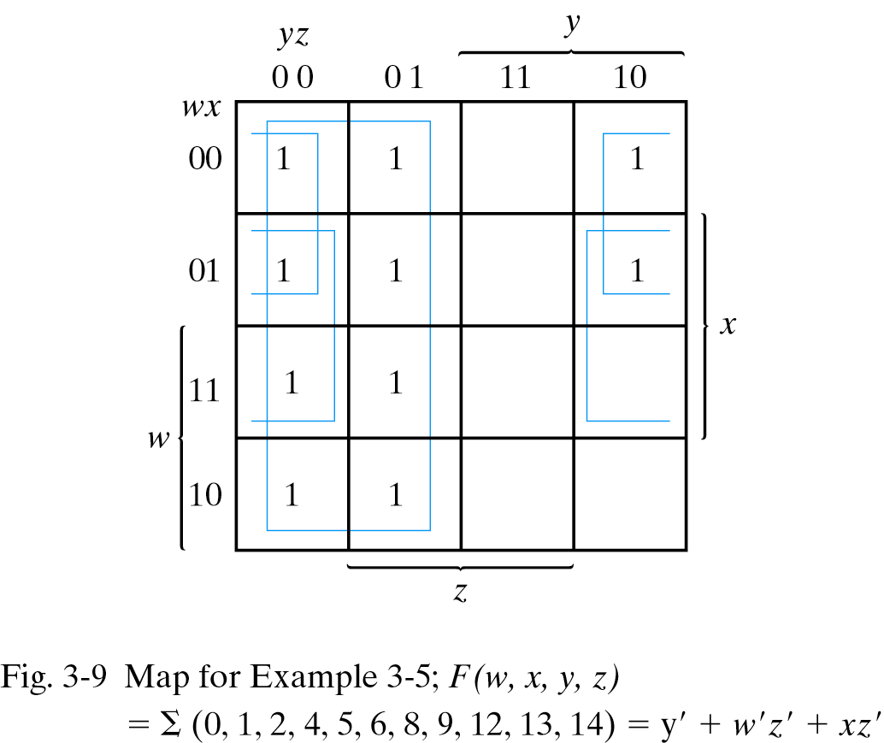
Four-Variable Map-example 1
1

Slide 35
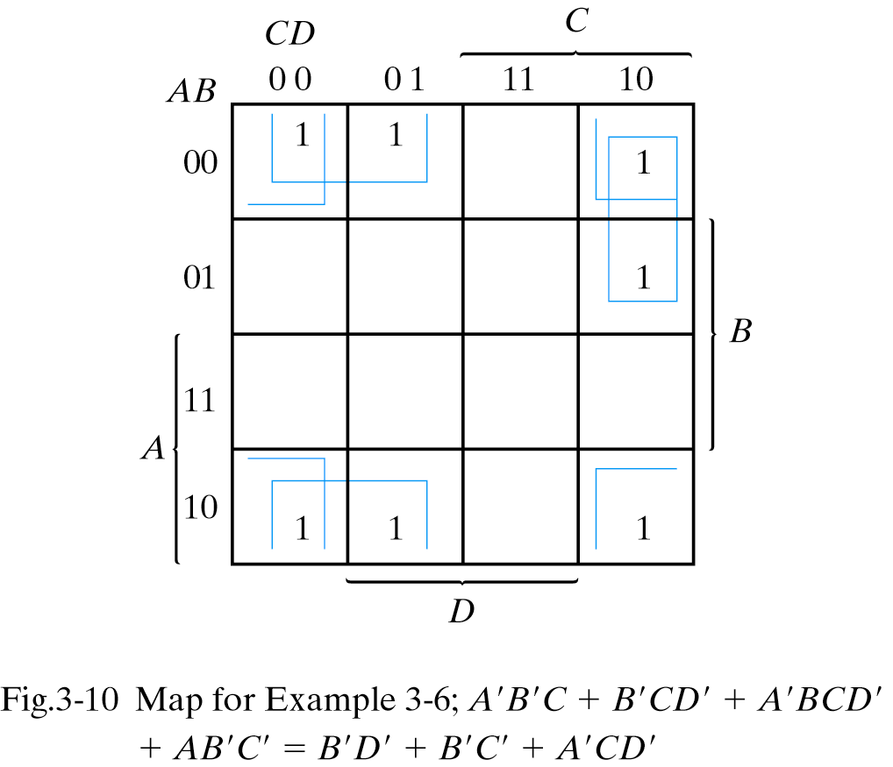
Four-Variable Map-example 2

Slide 36
Summary
Extension to multiple inputs
Positive & Negative Logic
Integrated Circuits
Gate Level Minimization

